Slide 1
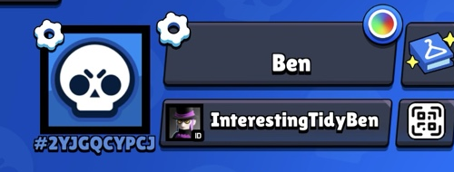
Brawl Stars Player Card
First mini app: type a Player Tag → see a cool profile card
How the app works
1. Type tag Paste #2YJGQGYPCJ
2. Click button “Show my card”
3. Ask our server
API key stays secret
4. See card trophies + brawlers
→
→
→
Ben’s tag: #2YJGQGYPCJ
What you learn
Secret rule
HTML makes the page
CSS makes it beautiful
JavaScript asks our local server
The server gets real game data
The API token is like a password.
Keep it only on our local server.
The API key allows our current public IP.
Lesson 1: run locally on the PC. Later: deploy using a backend with a fixed outbound IP.

